Slide 1
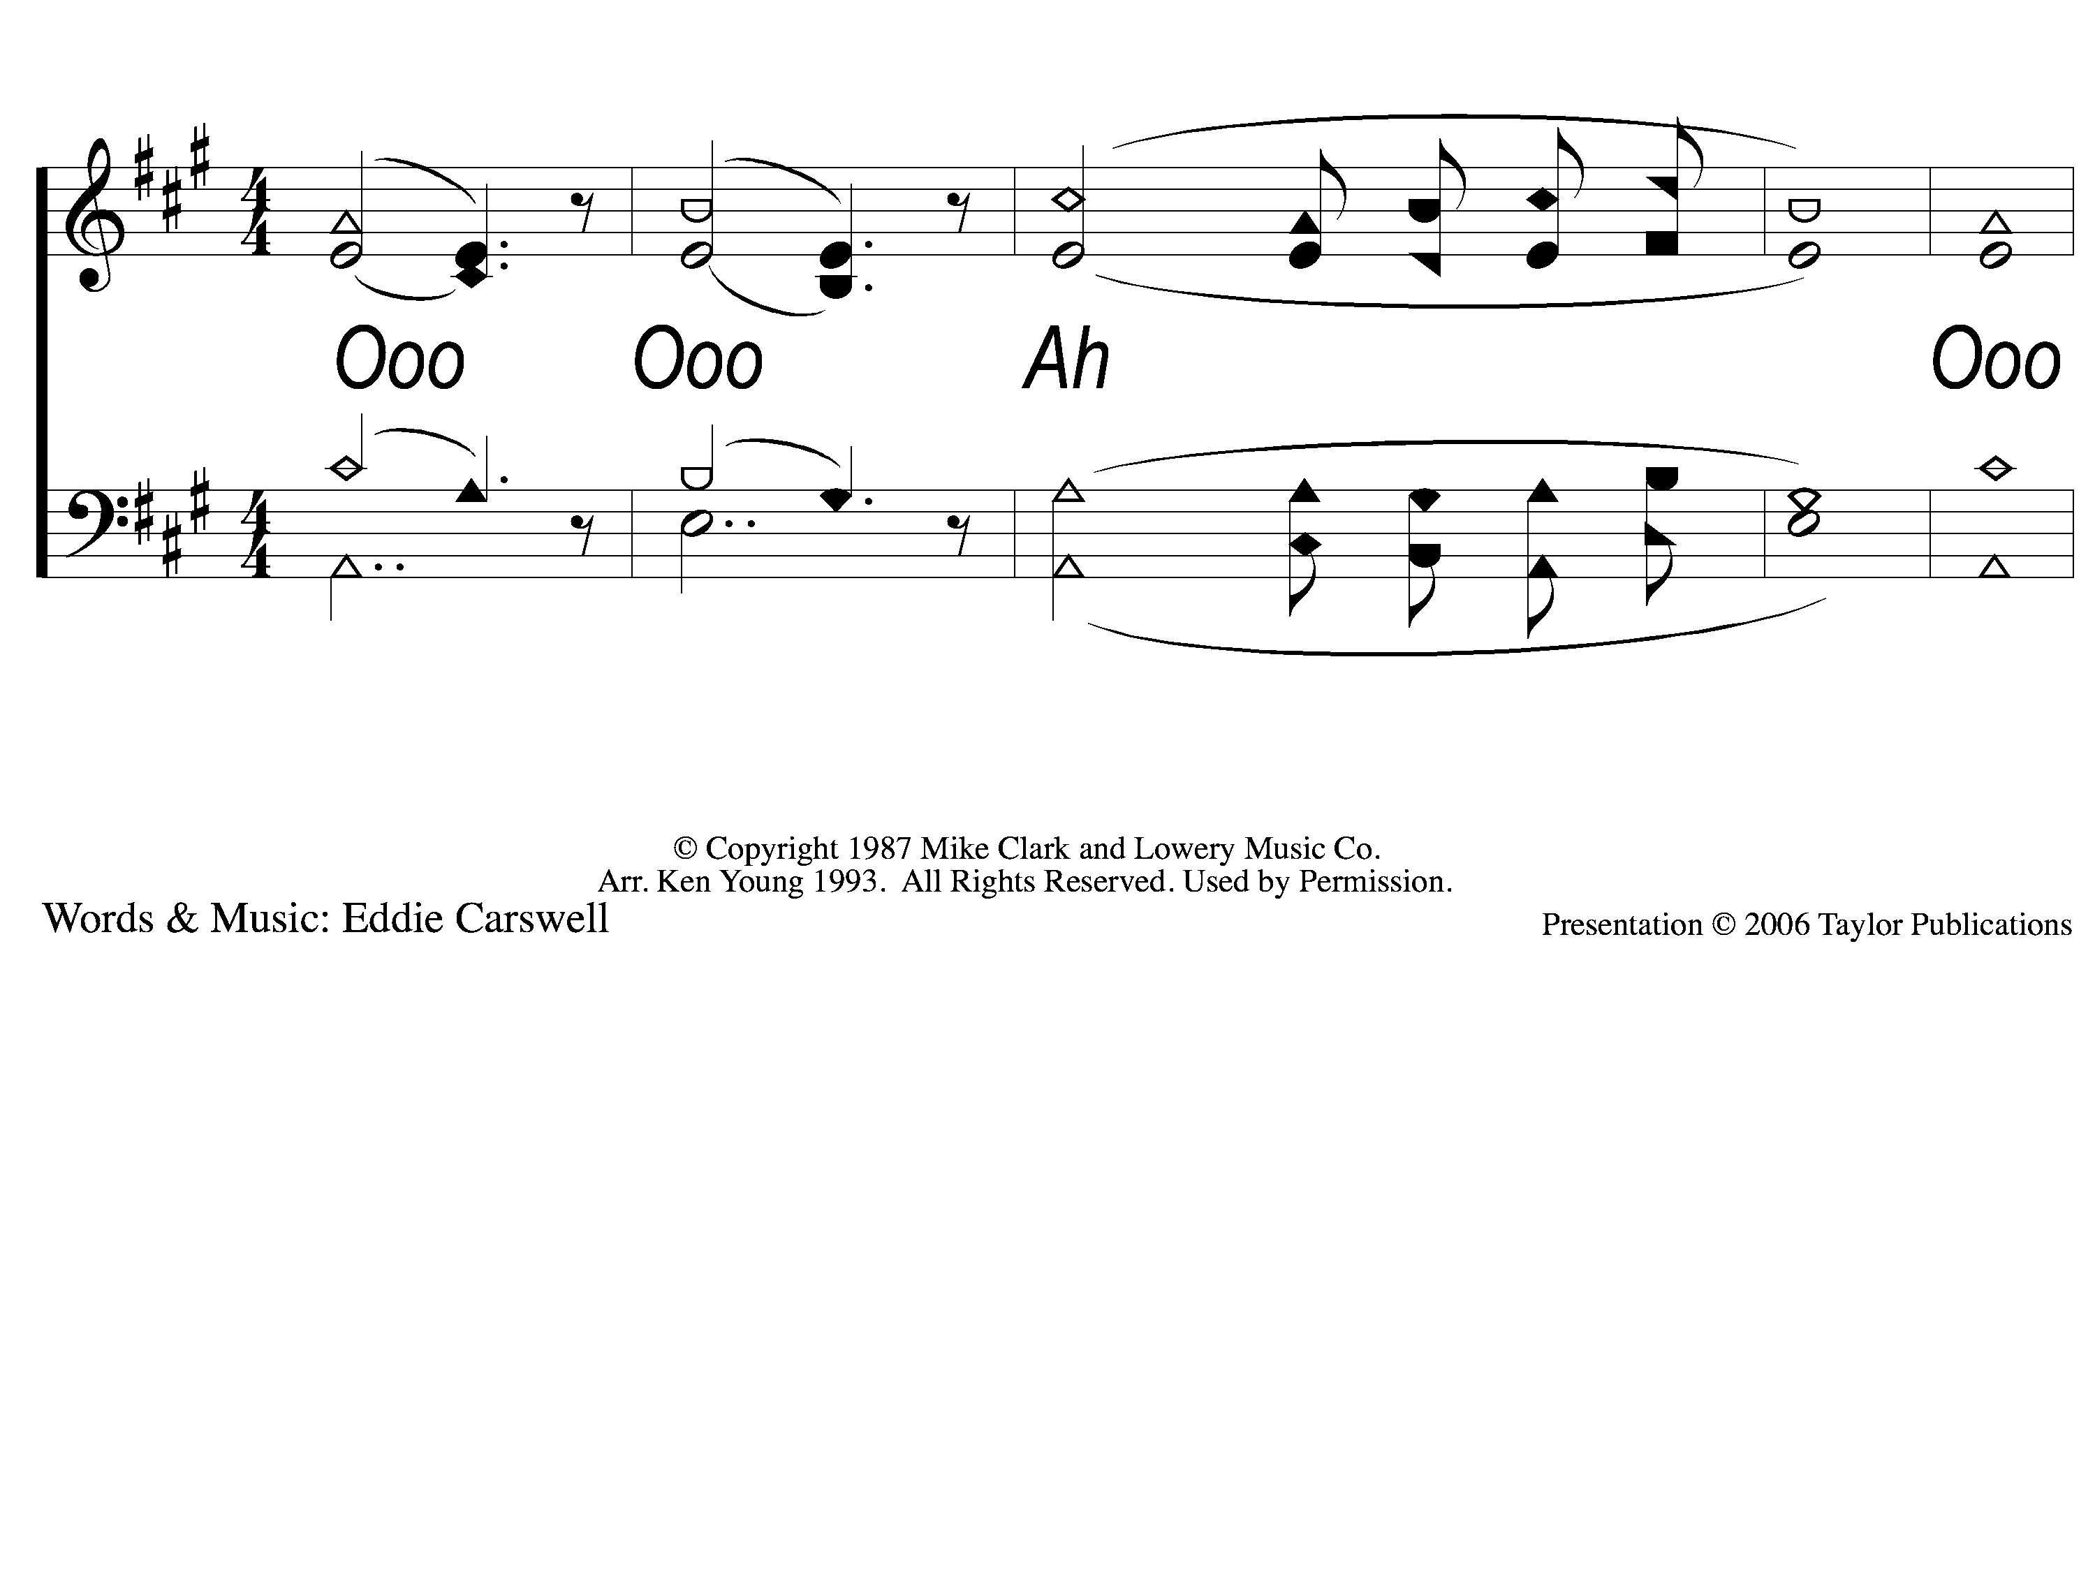
Intro Arise My Love
Arise, My Love
160

Slide 2
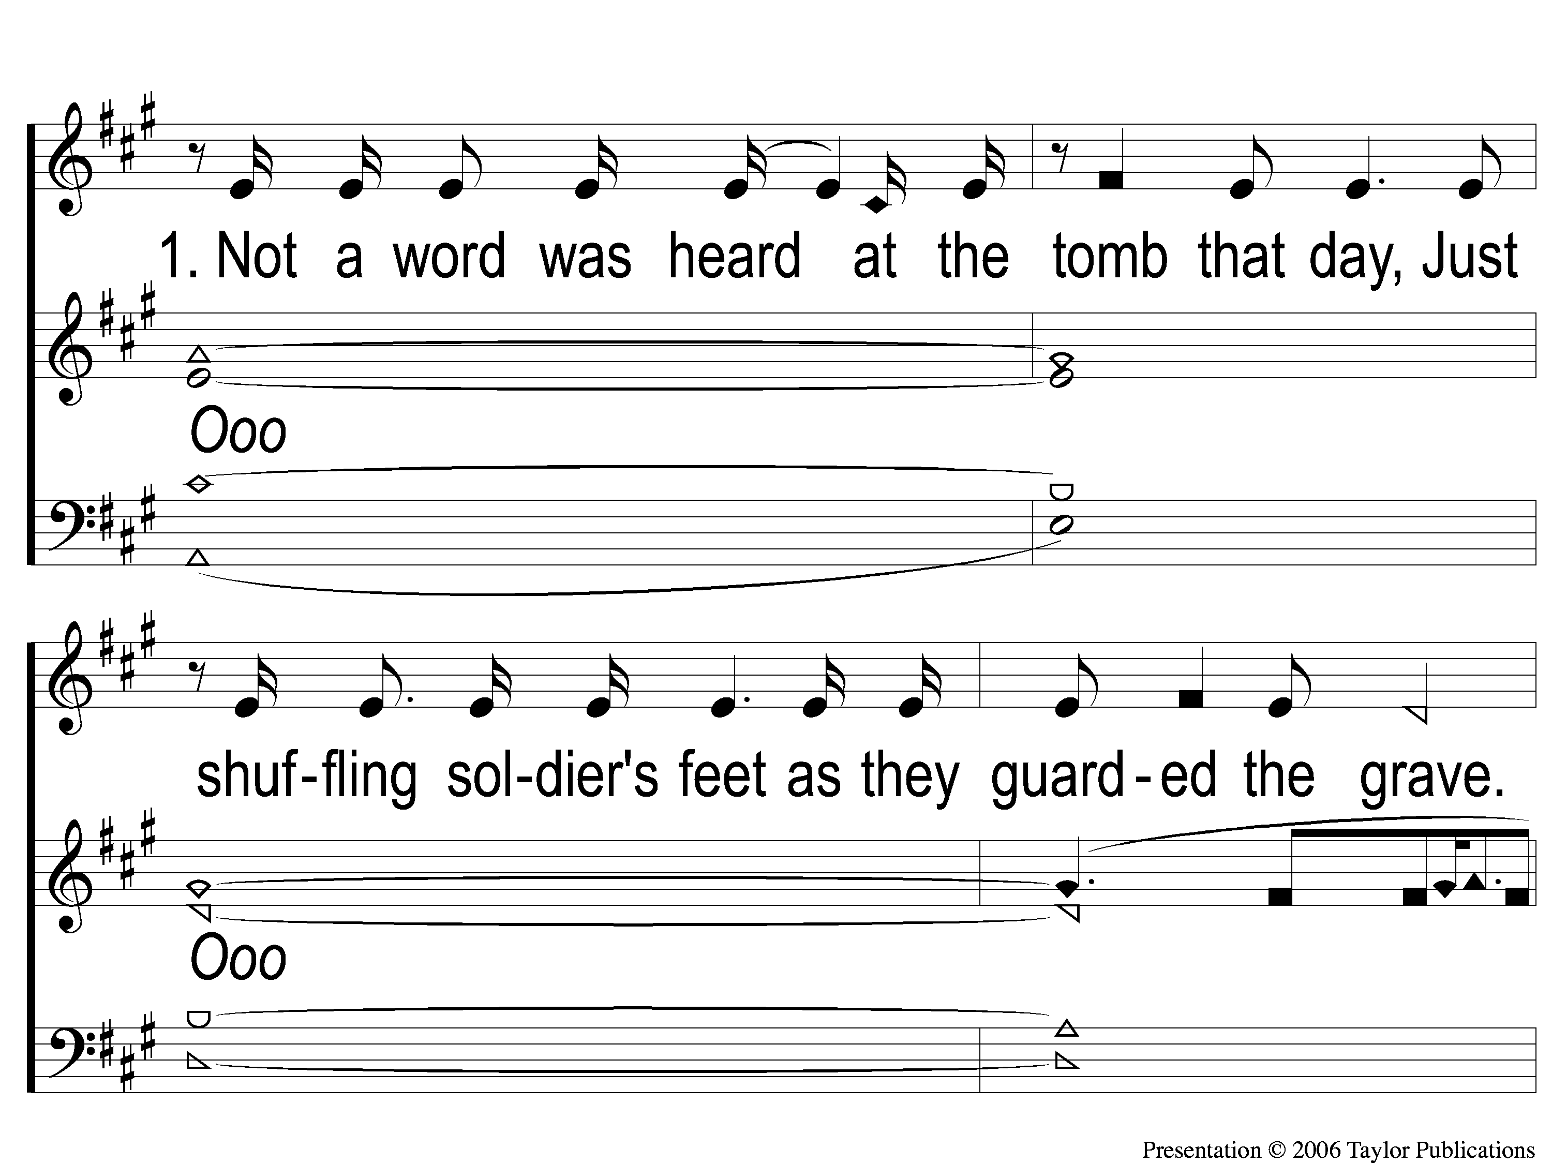
1-1 Arise My Love
Arise, My Love
160

Slide 3
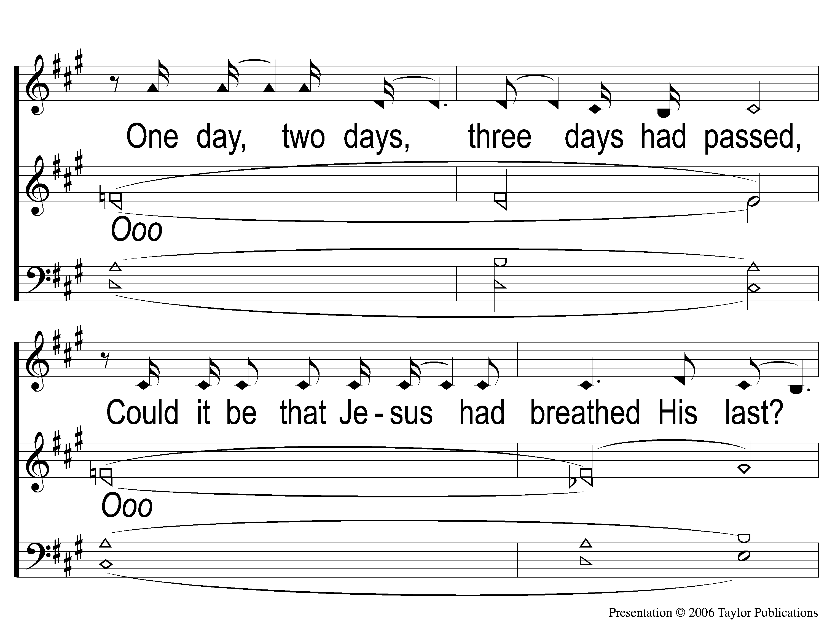
1-2 Arise My Love
Arise, My Love
160

Slide 4
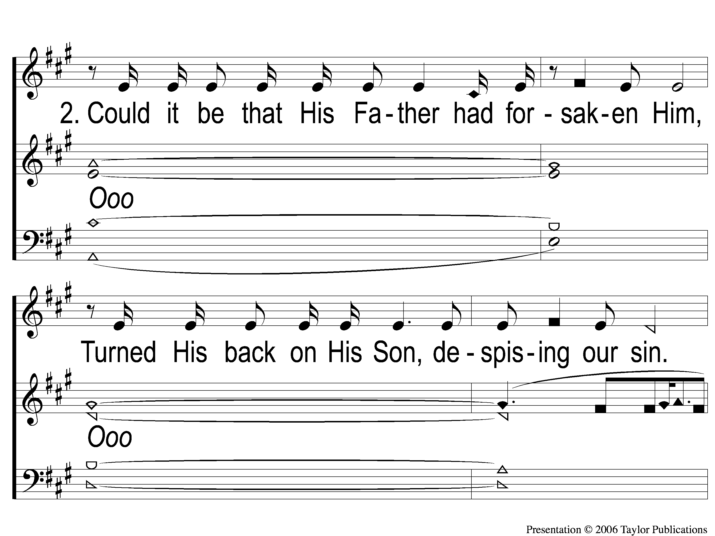
2-1 Arise My Love
Arise, My Love
160

Slide 5
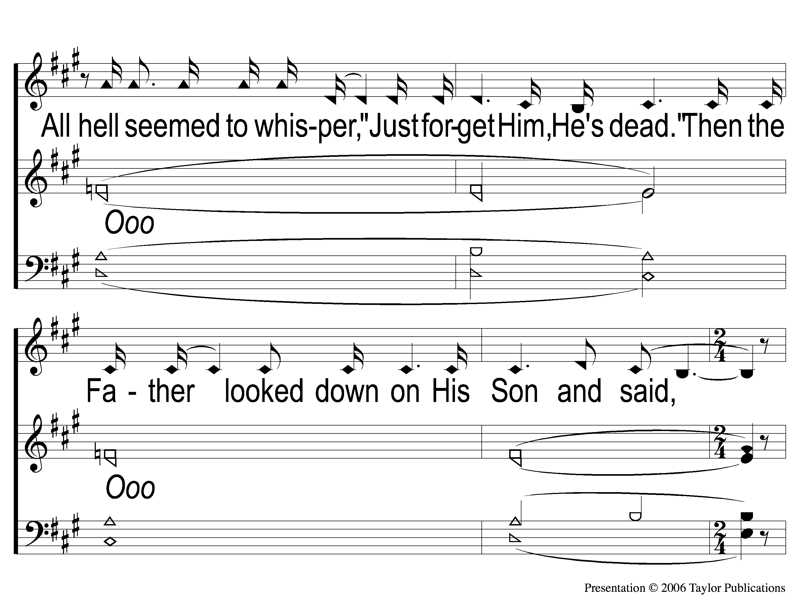
2-2 Arise My Love
Arise, My Love
160

Slide 6
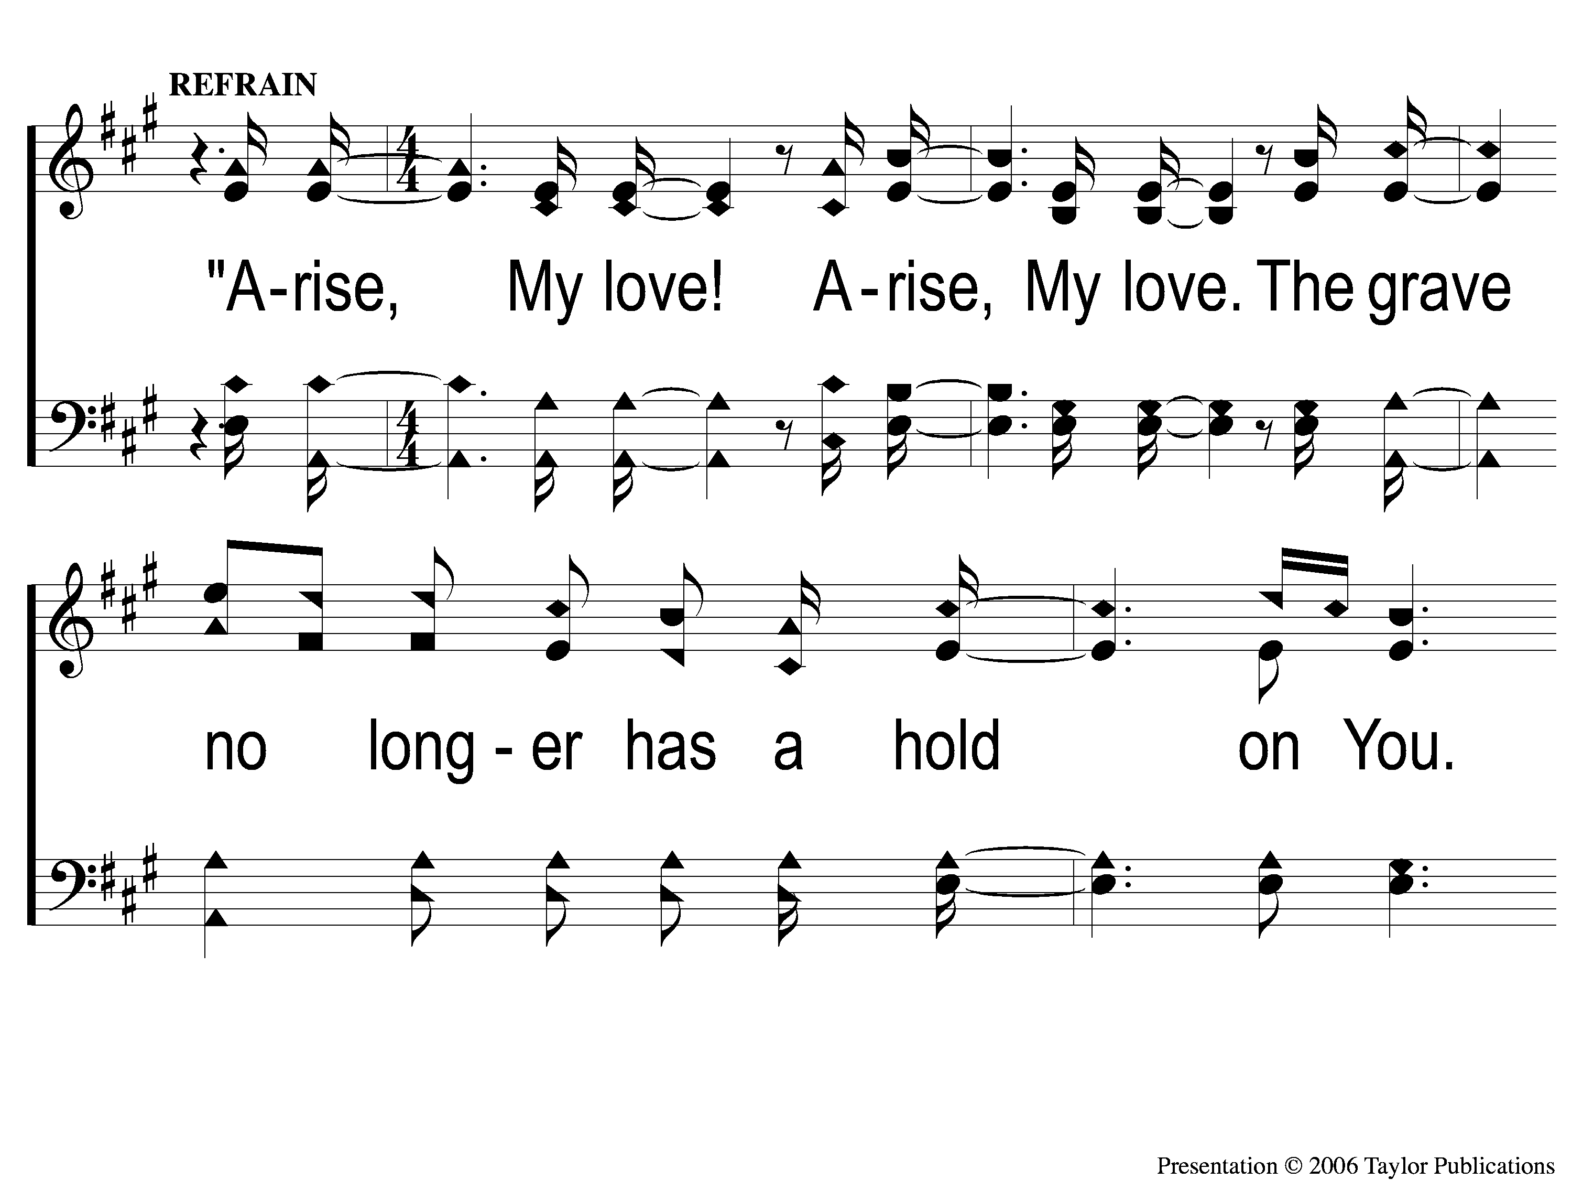
C-1 Arise My Love
Arise, My Love
160

Slide 7
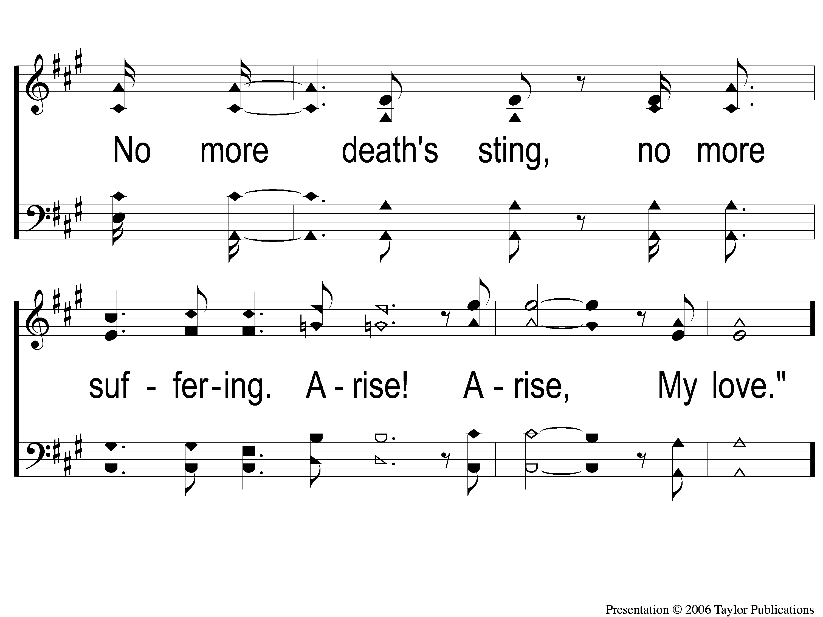
C-2 Arise My Love
Arise, My Love
160

Slide 8
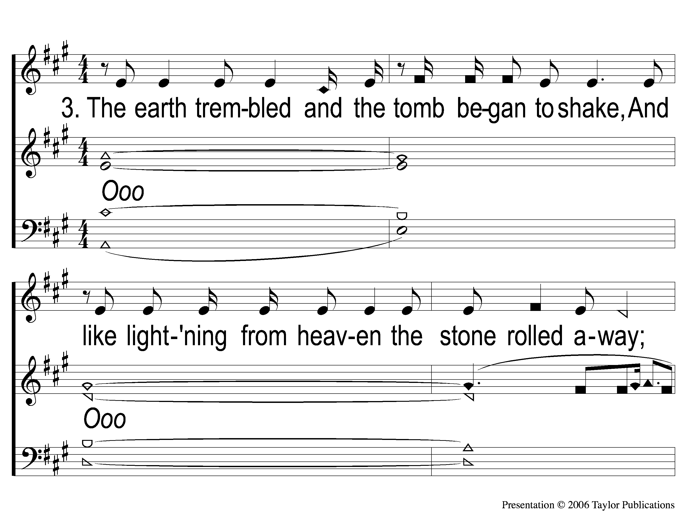
3-1 Arise My Love
Arise, My Love
160

Slide 9
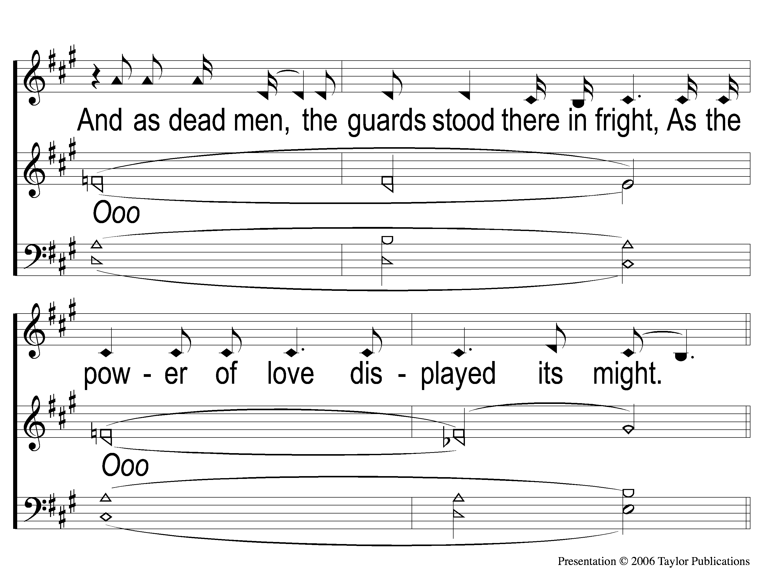
3-2 Arise My Love
Arise, My Love
160

Slide 10
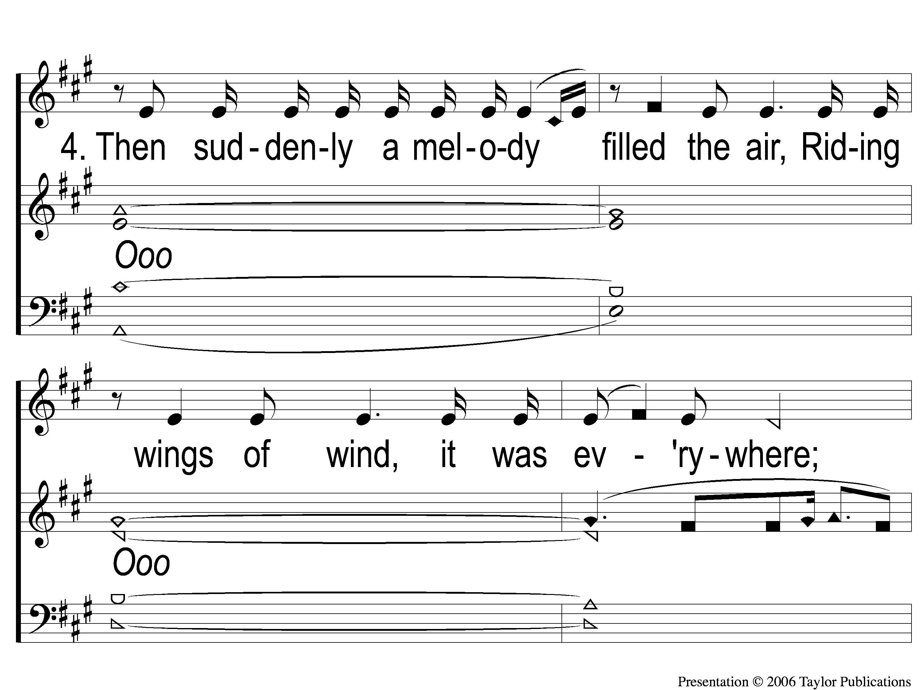
4-1 Arise My Love
Arise, My Love
160

Slide 11
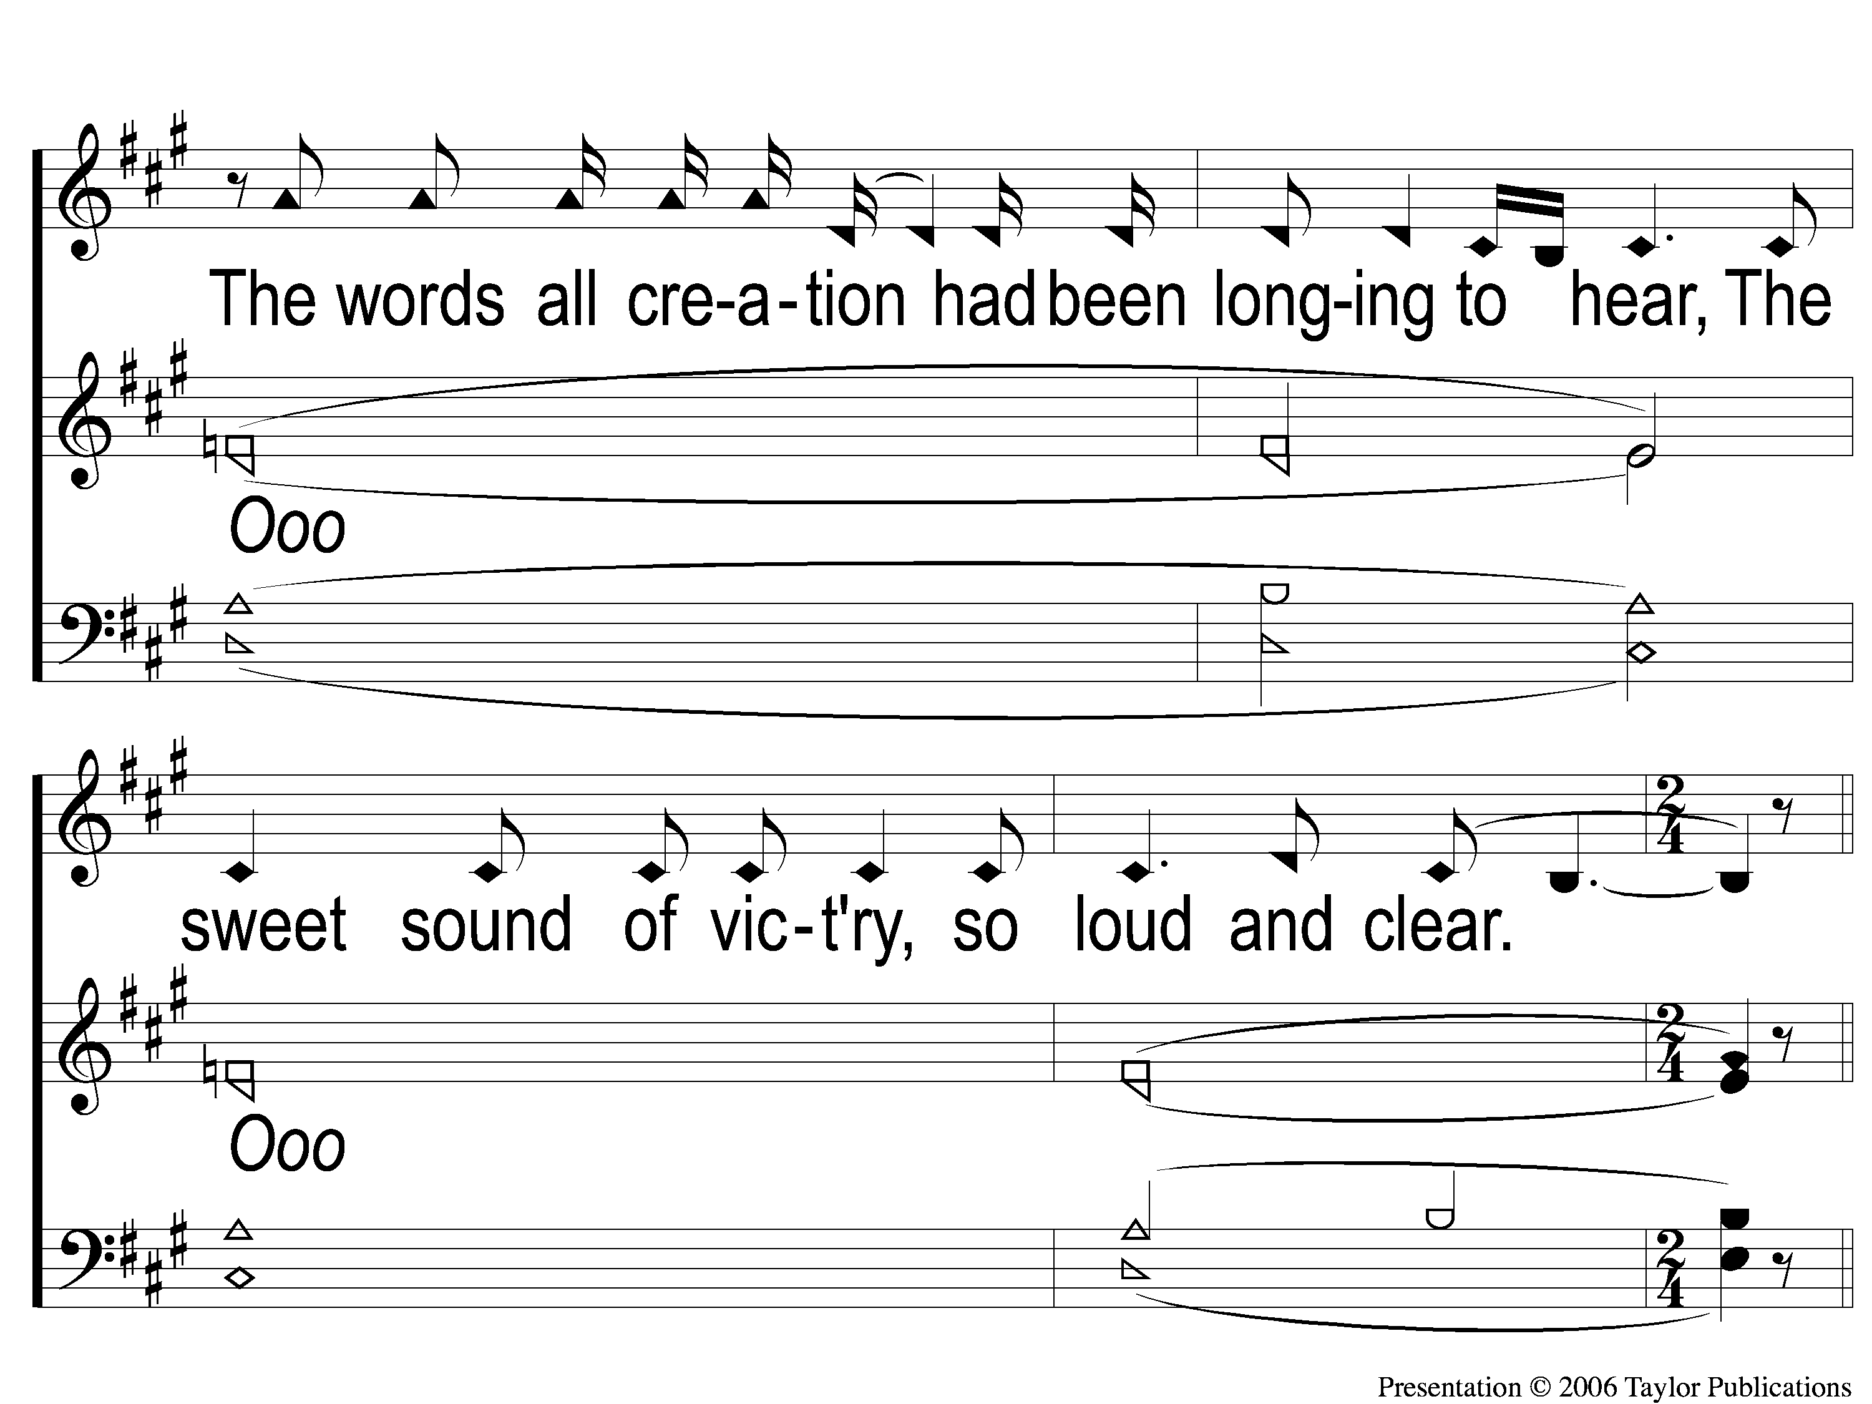
4-2 Arise My Love
Arise, My Love
160

Slide 12
C-1 Arise My Love
Arise, My Love
160

Slide 13
C-2 Arise My Love
Arise, My Love
160

